Slide 1
openDRIVE Map Generation
Share: Lingtong Zhang

Slide 2
Outline
JsonFile of ODM map
JsonFile of Scenario

Slide 3
Overview
{
"prefix":"lk",
"description":"constant_r700",
"junctions":[
"Merge",
"Split",
"Intersection"
],
"maps":[
{
"type":"non_connector",
"id":0,
"direction":"Uni",
"links":[
{
"parent":"None",
"child":"None"
}
],
"starter":[
"x=0.0",
"y=0.0"
],
"heading":0.0,
"lanes":[
{
"A":["type=line,dist=5000,left=True,num=3,width=3.75",
"type=line,dist=5000,right=True,num=3,width=3.75"]
}
],
"speed":100,
"builders":[
"line:dist=5000.0"
],
"elevations":[
"dist=5000.0,slope=-0.05"
]
}
]
}
Items | Instructions
Prefix | Name of Functional Scenario
Desciption | Map Name of Logical Scenario
Junctions | Supported Junction type (PS: “T”-Intersection is also included)
Maps | Details of Road Map

Slide 4
Overview
{
"prefix":"lk",
"description":"constant_r700",
"junctions":[
"Merge",
"Split",
"Intersection"
],
"maps":[
{
"type":"non_connector",
"id":0,
"direction":"Uni",
"links":[
{
"parent":"None",
"child":"None"
}
],
"starter":[
"x=0.0",
"y=0.0"
],
"heading":0.0,
"lanes":[
{
"A":["type=line,dist=5000,left=True,num=3,width=3.75",
"type=line,dist=5000,right=True,num=3,width=3.75"]
}
],
"speed":100,
"builders":[
"line:dist=5000.0"
],
"elevations":[
"dist=5000.0,slope=-0.05"
]
}
]
}
Map Items | Instructions
type | Connector- road-segment that build linkage between two or more main roads Non_connector- main road
id | -
direction | Bio- Dual carriageway Uni- Single carriageway
links | Predecessor and Successor of Current Road Segment Parent - (Road, Junction, None) Child - (Road, Junction, None)
starter & heading | Start point of current road segment (global coordinate system) For roads with “None” parent only

Slide 5
Overview
{
"prefix":"lk",
"description":"constant_r700",
"junctions":[
"Merge",
"Split",
"Intersection"
],
"maps":[
{
"type":"non_connector",
"id":0,
"direction":"Uni",
"links":[
{
"parent":"None",
"child":"None"
}
],
"starter":[
"x=0.0",
"y=0.0"
],
"heading":0.0,
"lanes":[
{
"A":["type=line,dist=5000,left=True,num=3,width=3.75",
"type=line,dist=5000,right=True,num=3,width=3.75"]
}
],
"speed":100,
"builders":[
"line:dist=5000.0"
],
"elevations":[
"dist=5000.0,slope=-0.05"
]
}
]
}
Map Items | Instructions
lanes | Series of Lane Sections: type- Lane section with no change of lane nums or lane width dist - Length of current lane section left, right- Postion relative to road center line num- / width- / type- (value: “line”, “poly”)
speed | Maximum Speed Allowance
builders | Geometries Definition of Current Road Keys: “line”, “spiral”, “arc”
elevations | Elevations Definition of Current Road dist- Distance slope- Tangent

Slide 6

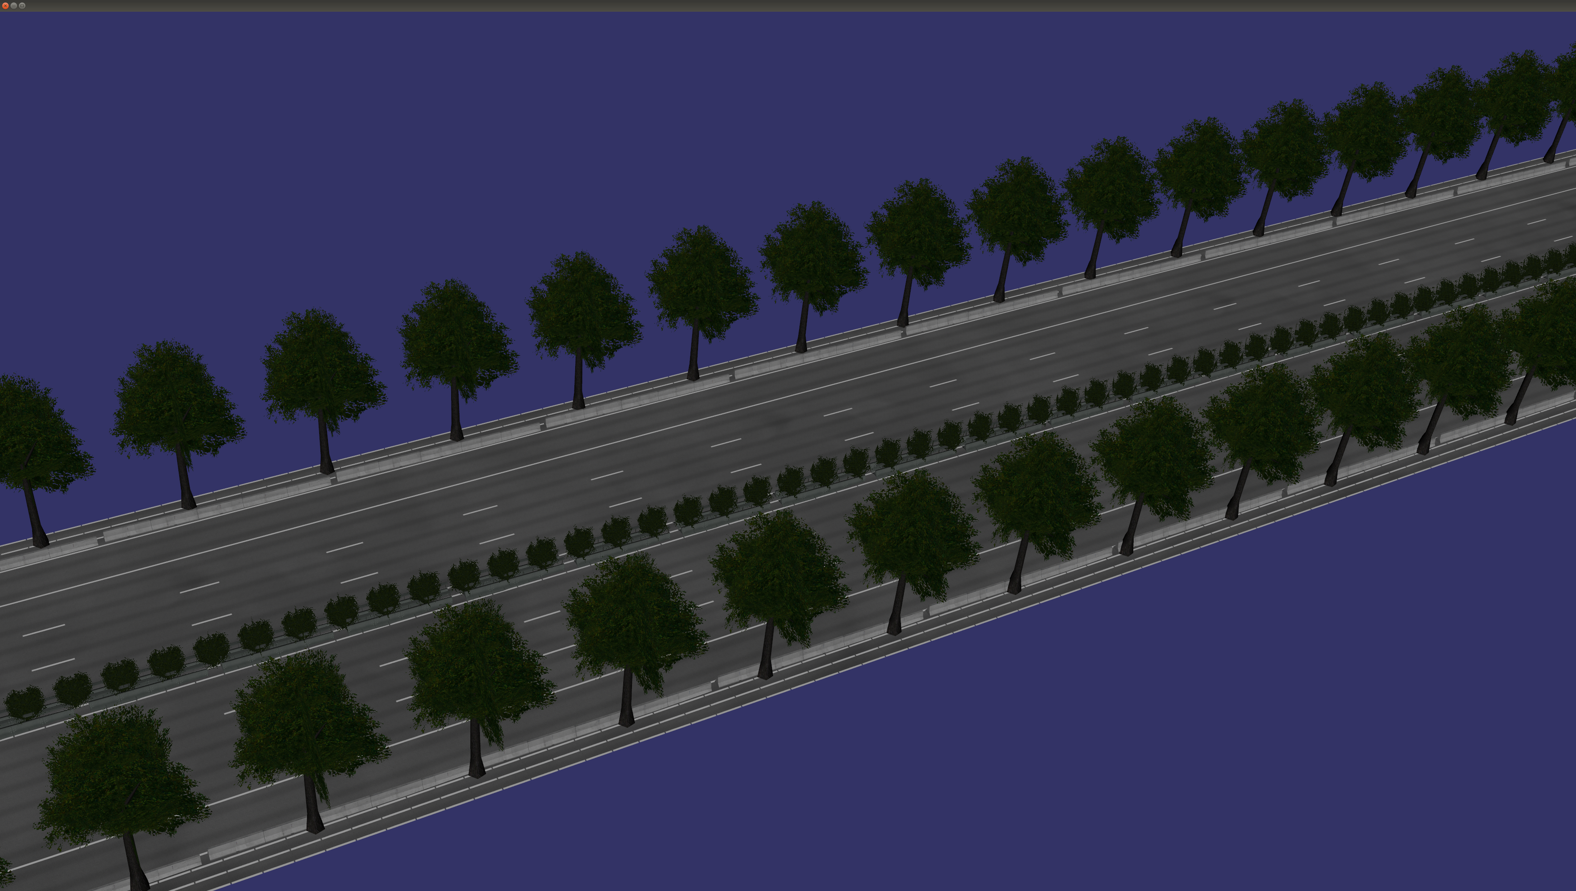
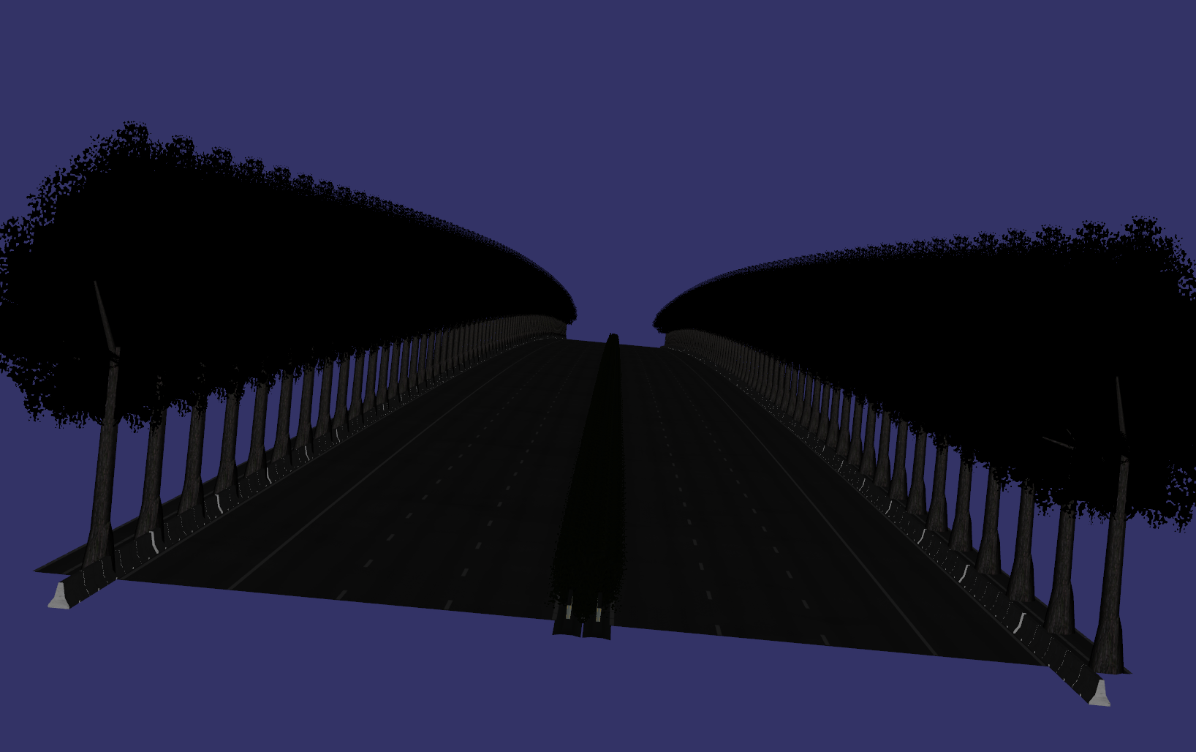
Render

Slide 7
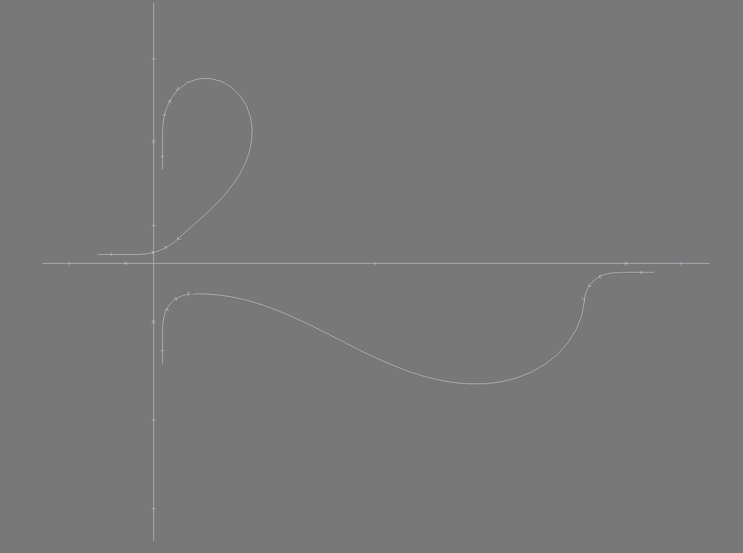
Complicated Road Network

Slide 8
Outline
JsonFile of ODM map
JsonFile of Scenario

